Slide 1
Giftly
Your Home for Gifting Perfection

Slide 2
The Hero You Didn’t Know You Needed
Need for a simple, organized shopping list to shop for friends
Be able to refine search by price point
Have it all save for later use and be mobile user friendly
Notes:
With Christmas coming up, we felt that there was a need for a simple app to be able to save a friends list, search for items in a general category, save specific items to a specific friend, and then be able to reference all later on a mobile format while shopping.

Slide 3
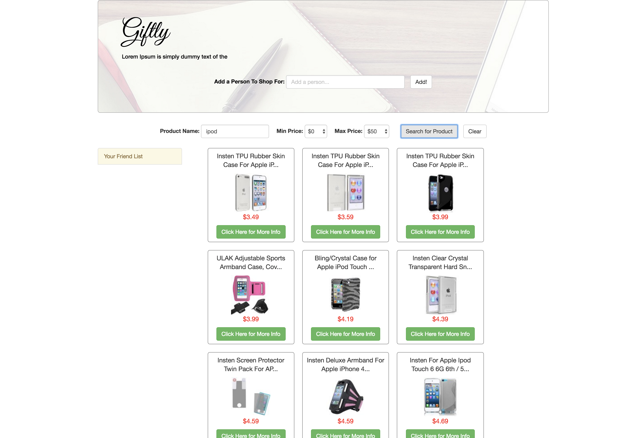
Focus and Development of App
Utilized Walmart API for shopping
Ensured Responsiveness
Ability to add multiple friends for easy shopping
Give ability to search by price range
Display 21 items and sort by price relating to the product search
Bring the user to Walmart product page for purchasing
Notes:
We had a tough time finding an API that used JSON and that we could manipulate to what we needed to pull from it. We finally settled on the Walmart API. This also allowed us to key on searching by product price point and sorting each search from least expensive to most expensive within the 20 product data return. We then linked our App to Walmart.com so that the user could make a purchase.

Slide 4
The Building Process
HTML
CSS
Bootstrap
Javascript
jQuery
JSON
JSONP
Git / GitHub
Google Firebase
Heroku
Notes:
"JSON with Padding" (and JSON stands for JavaScript Object Notation), is a way to get data from another domain that bypasses CORS (Cross Origin Resource Sharing) rules. CORS is a set of "rules," about transferring data between sites that have a different domain name from the client.

Slide 5
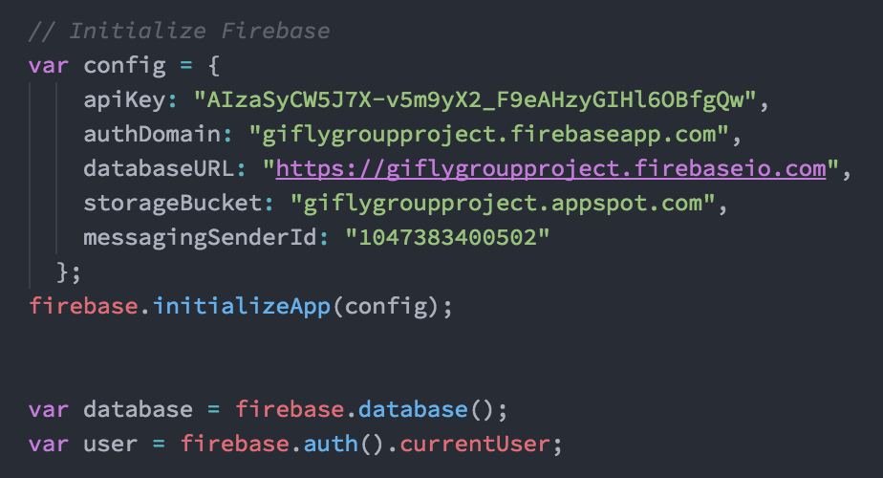
Initialize Firebase
Utilized Firebase to ensure user account access and be able to save data

Slide 6
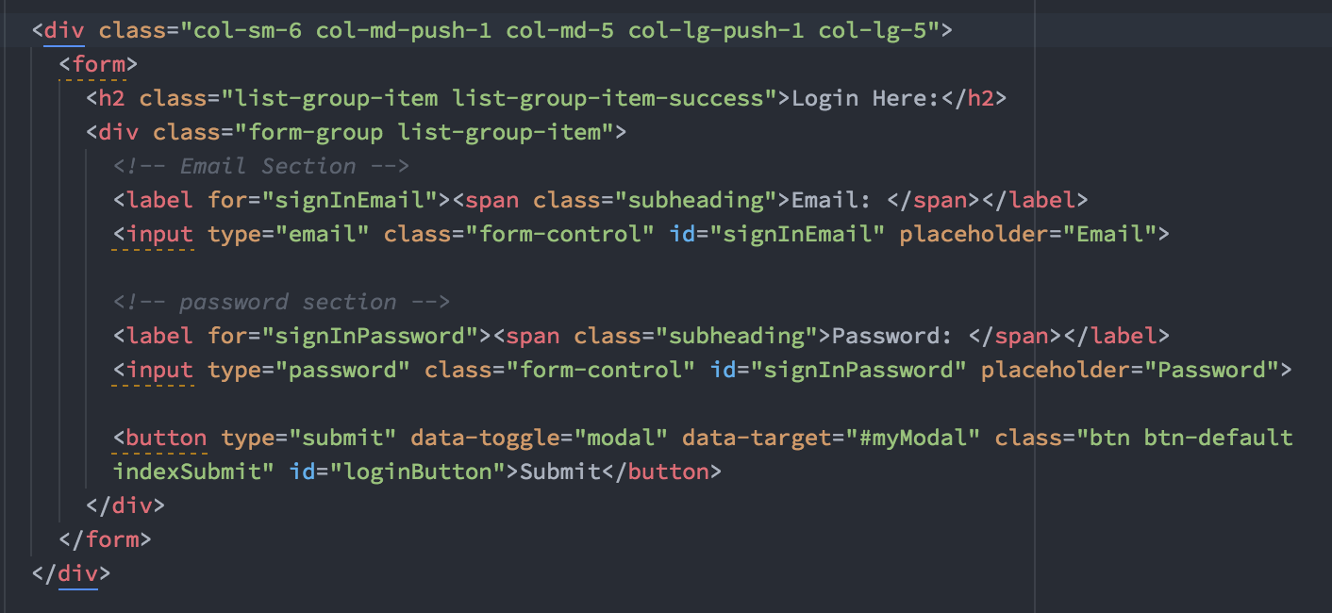
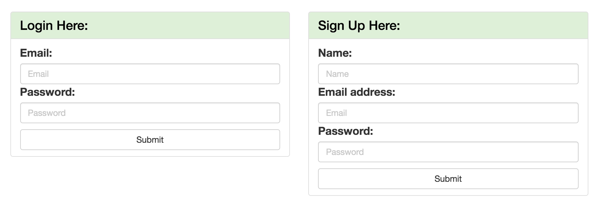
User Development
Authentication and Real-time Database
Create User Account
User Login Area
Notes:
Sign Up and Login are stored in Firebase for user authentication and access.

Slide 7
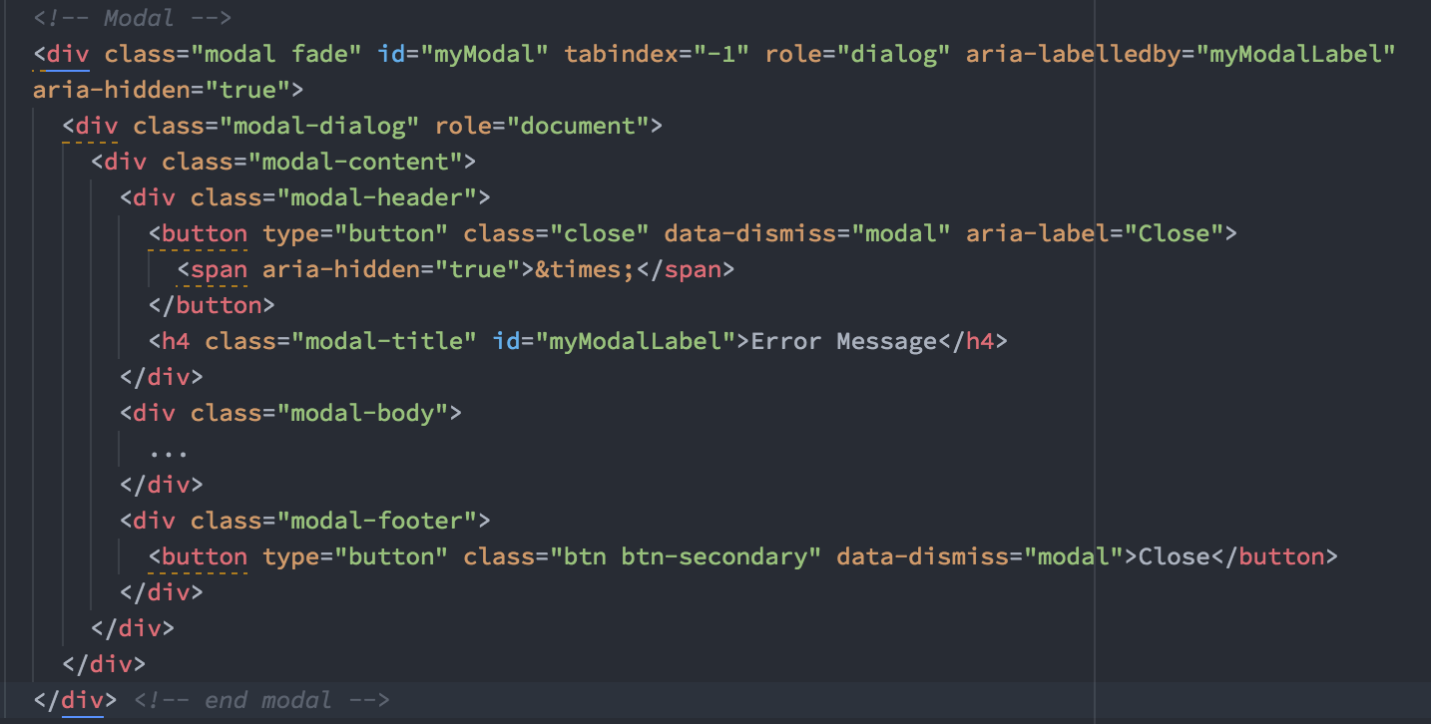
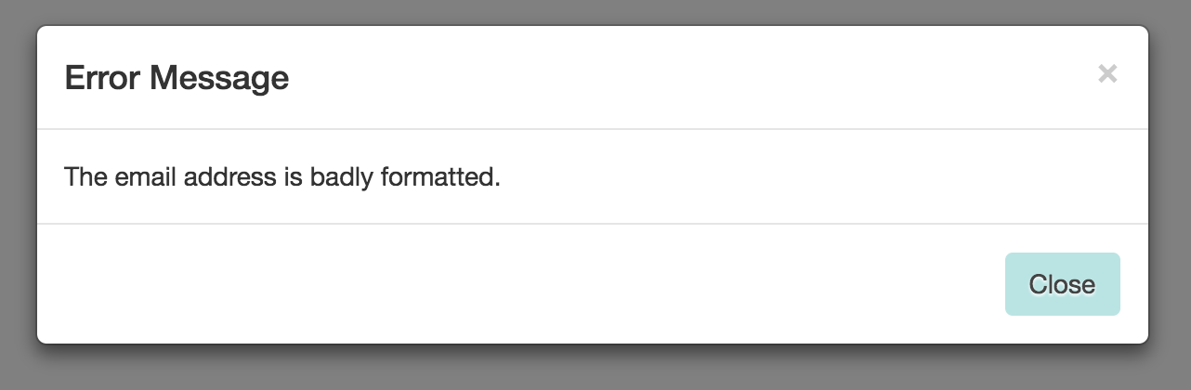
Creating User Validation through Modal
Created Modal via Bootstrap to ensure all fields are correct or alert user of an error.

Slide 8

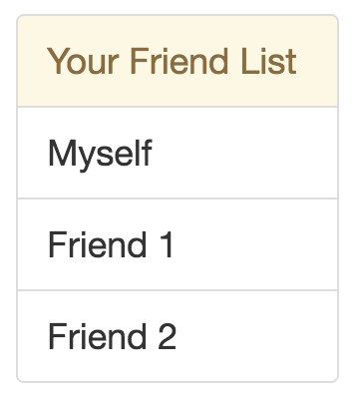
Adding to Friend List
Create your friend list via the form in the header

Slide 9
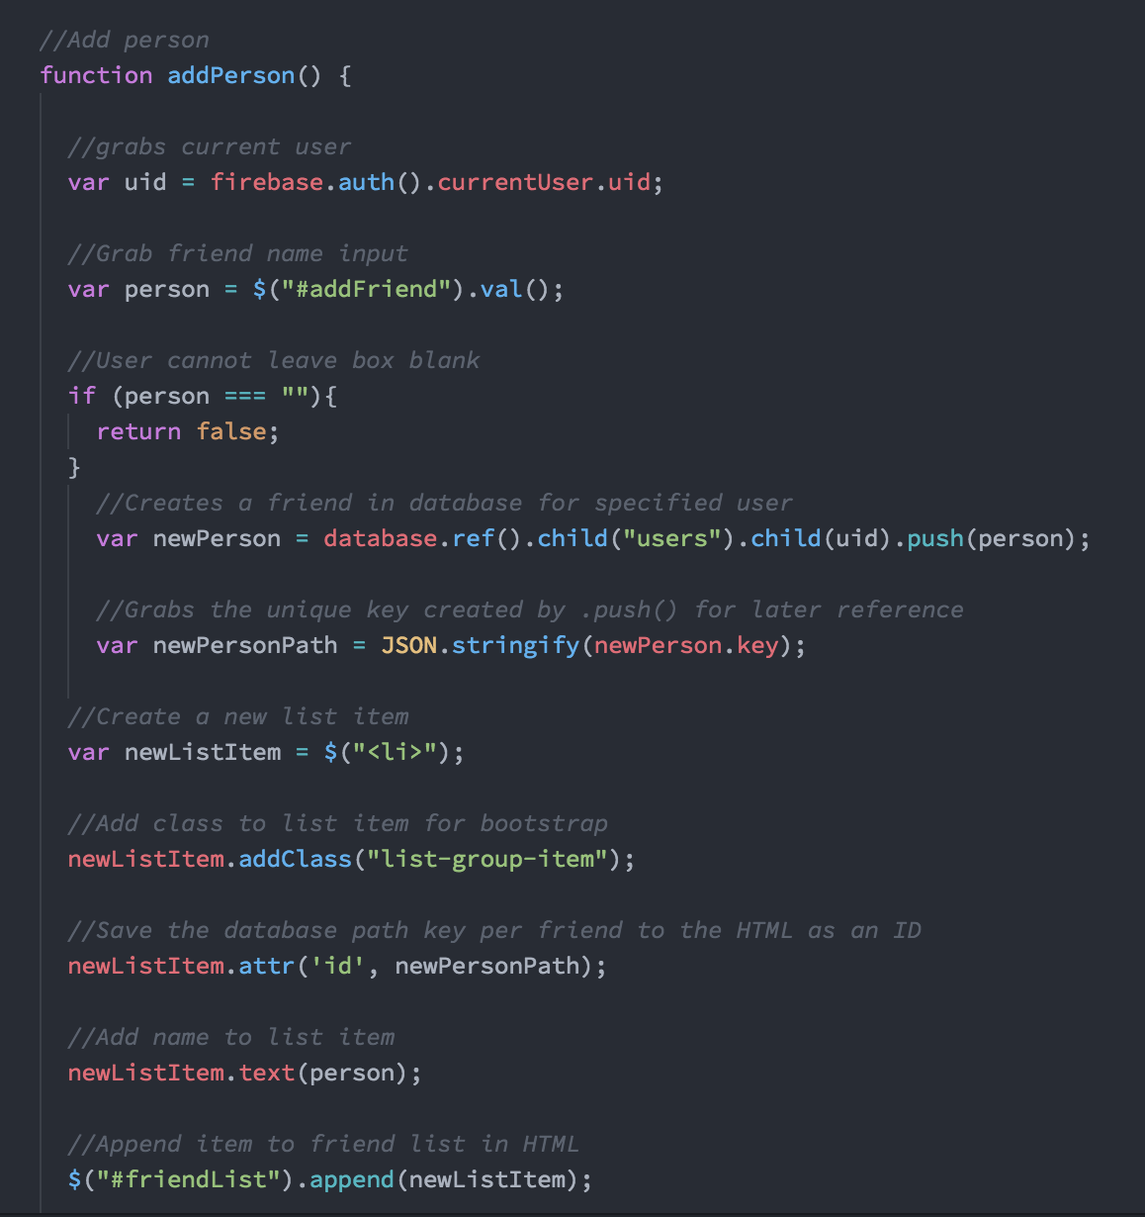
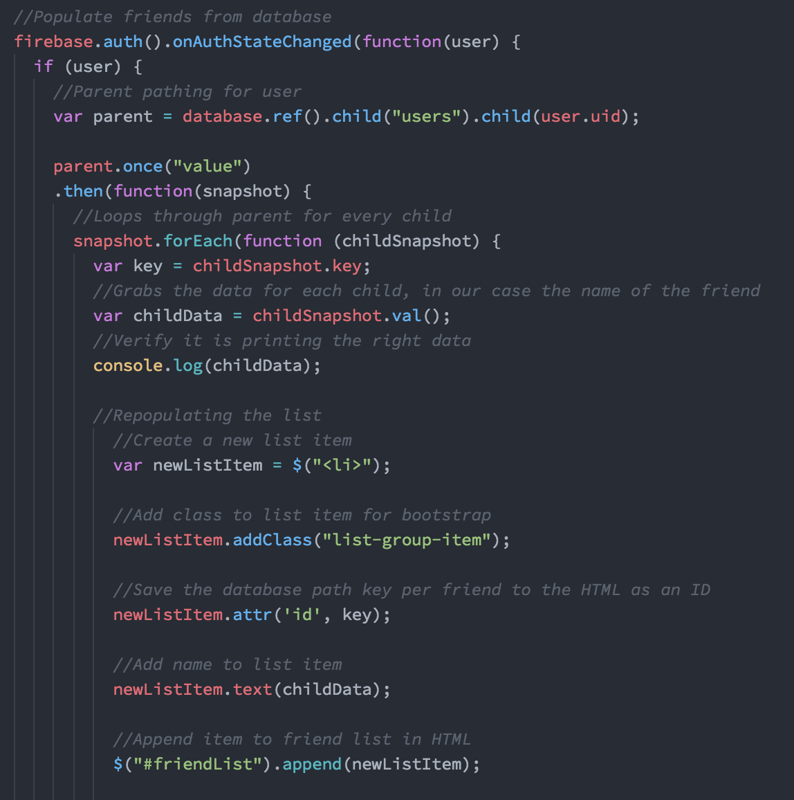
Code Snippet of Adding Friends

Slide 10
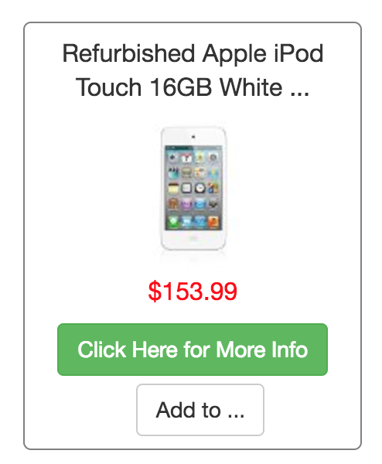
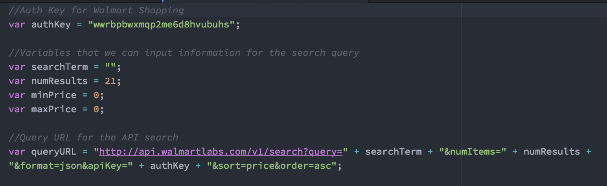
Search for Items

Slide 11
Other Features
Shows current user logged in
Sign out

Slide 12
Future Versions
Importation of Facebook Friend list
Additional Shopping API
Create Own Checkout within App
Add Map access for mobile use

